Slide 1


Tableau Project Sales Performance Analysis
Jamuna J. Mahalingam
School of Business, Economics, and Technology
DS61380H124
October 11, 2024
1

Slide 2

ABOUT
Jamuna J. Mahalingam
Graduate Student in Data Science & Artificial Intelligence
Email: jmaha939@students.campbellsville.edu
School of Business, Economics, and Technology
2

Slide 3
Requirements Analysis
Tableau Project
Step 1: Analyze, collect requirements
Step 2: Build Data Source
Step 3: Build Charts
Step 4: Build Dashboards
(Peesker et al., 2022)
School of Business, Economics, and Technology
4

Slide 4
Objectives
Build dashboards in Tableau to
Assist stakeholders, including sales and marketing teams, and management
Analyze sales performance and perform customers analysis
2 dynamic dashboards
Sales Dashboard and Customer Dashboard
Enable customers to view historical statistics by allowing them to pick any desired year
Allow users to effortlessly browse between dashboards
Interactive charts and graphs, allowing users to sift data
Data filters - to allow users to sift data based on product categories, subcategories, year and geography
(Parhusip et al., 2022; Sinlae et al., 2024)
School of Business, Economics, and Technology
4

Slide 5
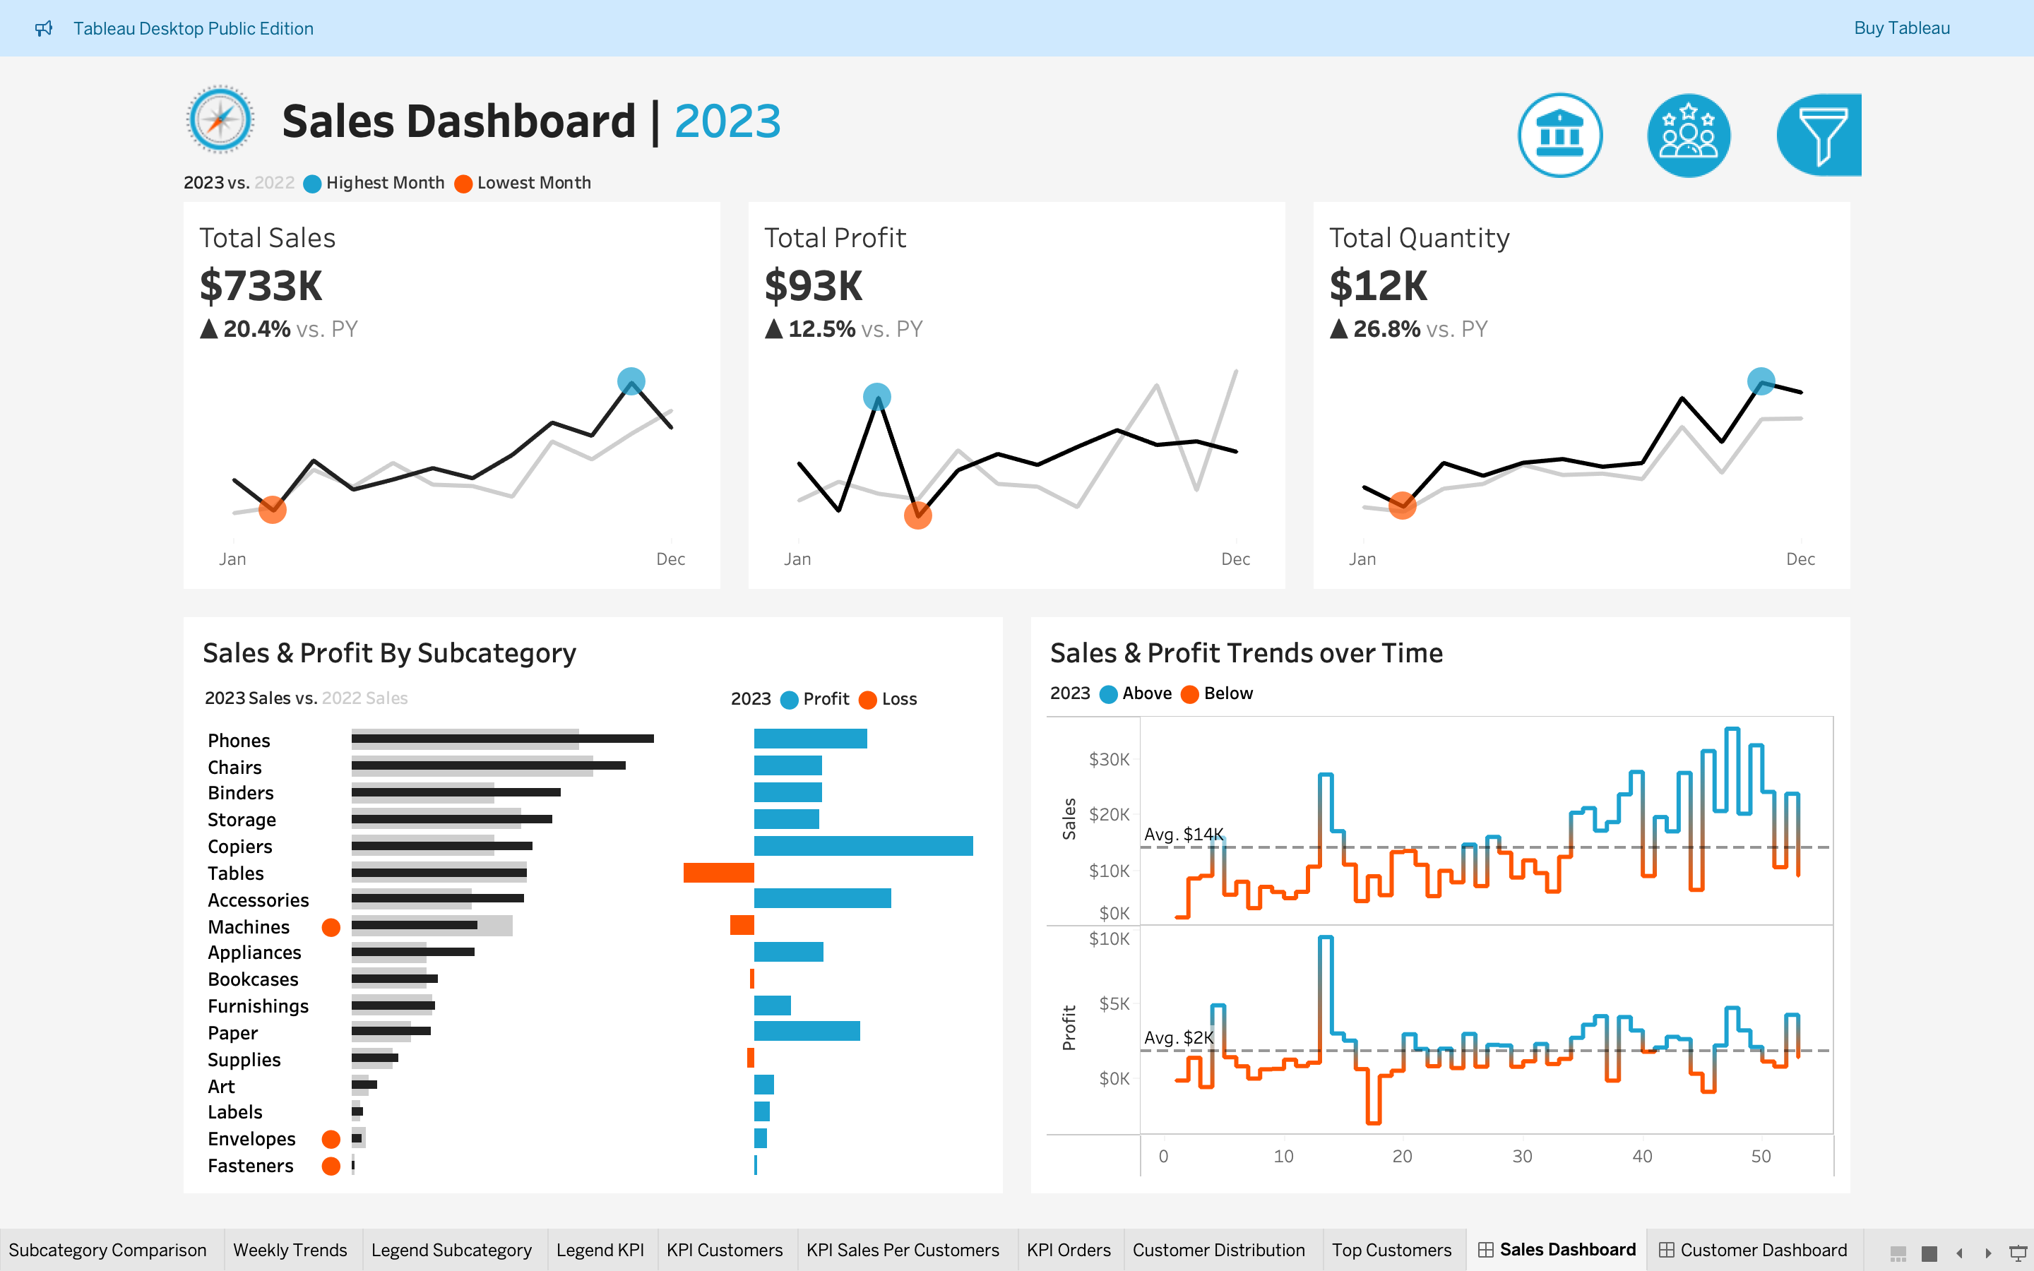
Sales Dashboard
Objective
Provide an overview of sales indicators and trends
Compare year-over-year sales performance and understand sales patterns
(Kallel et al., 2024)
School of Business, Economics, and Technology
4

Slide 6
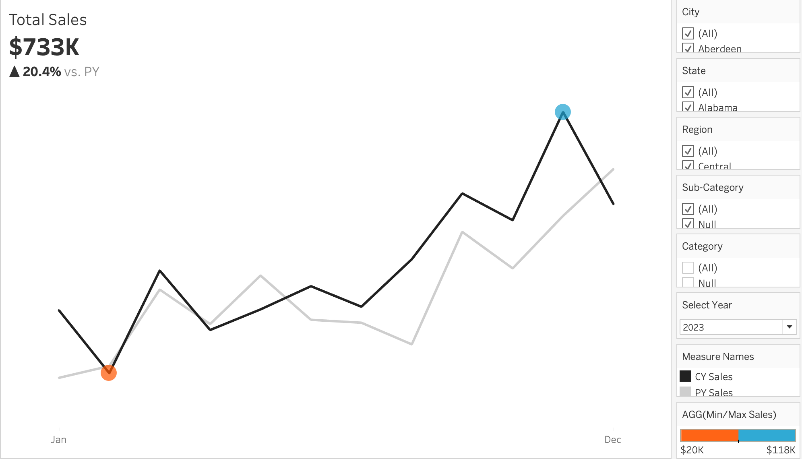
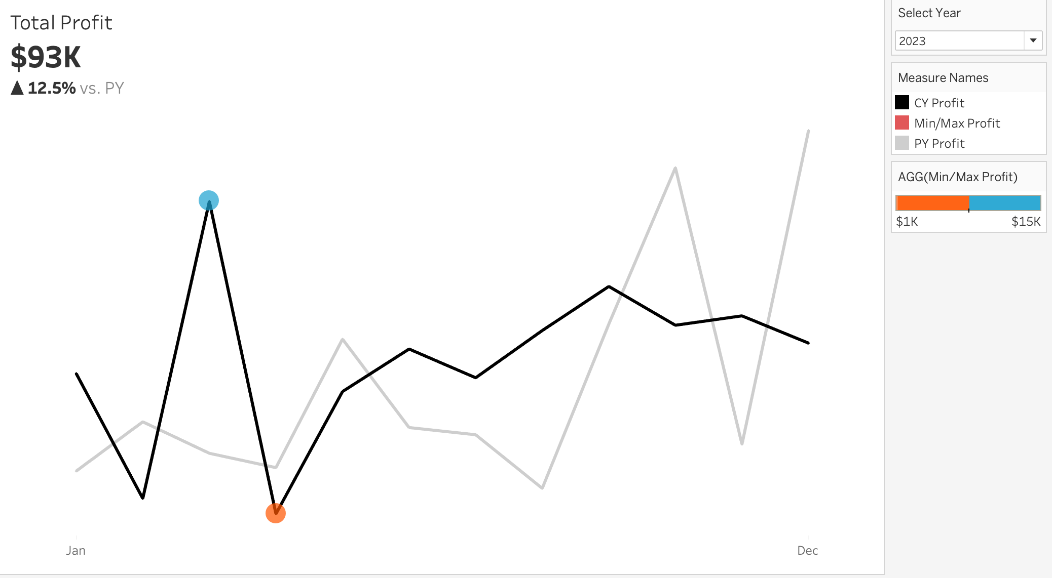
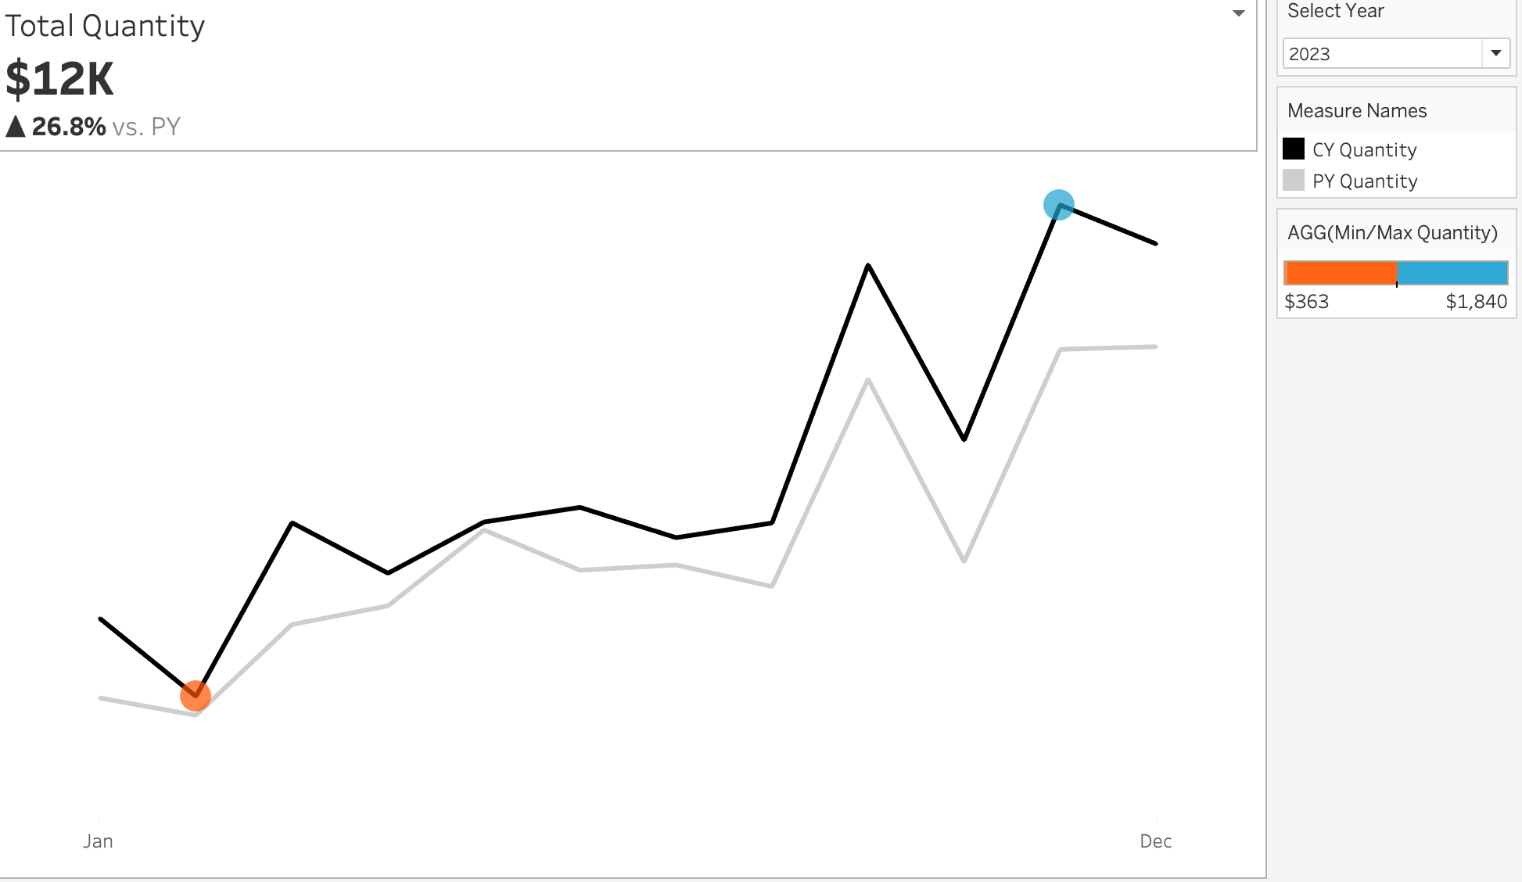
Sales Dashboard KPI Overview
Present monthly data for each Key Performance Indicator (KPI) for both the current and previous years
Easily recognize and identify months with highest and lowest sales
KPI Sales
KPI Profit
KPI Quantity
School of Business, Economics, and Technology
4

Slide 7
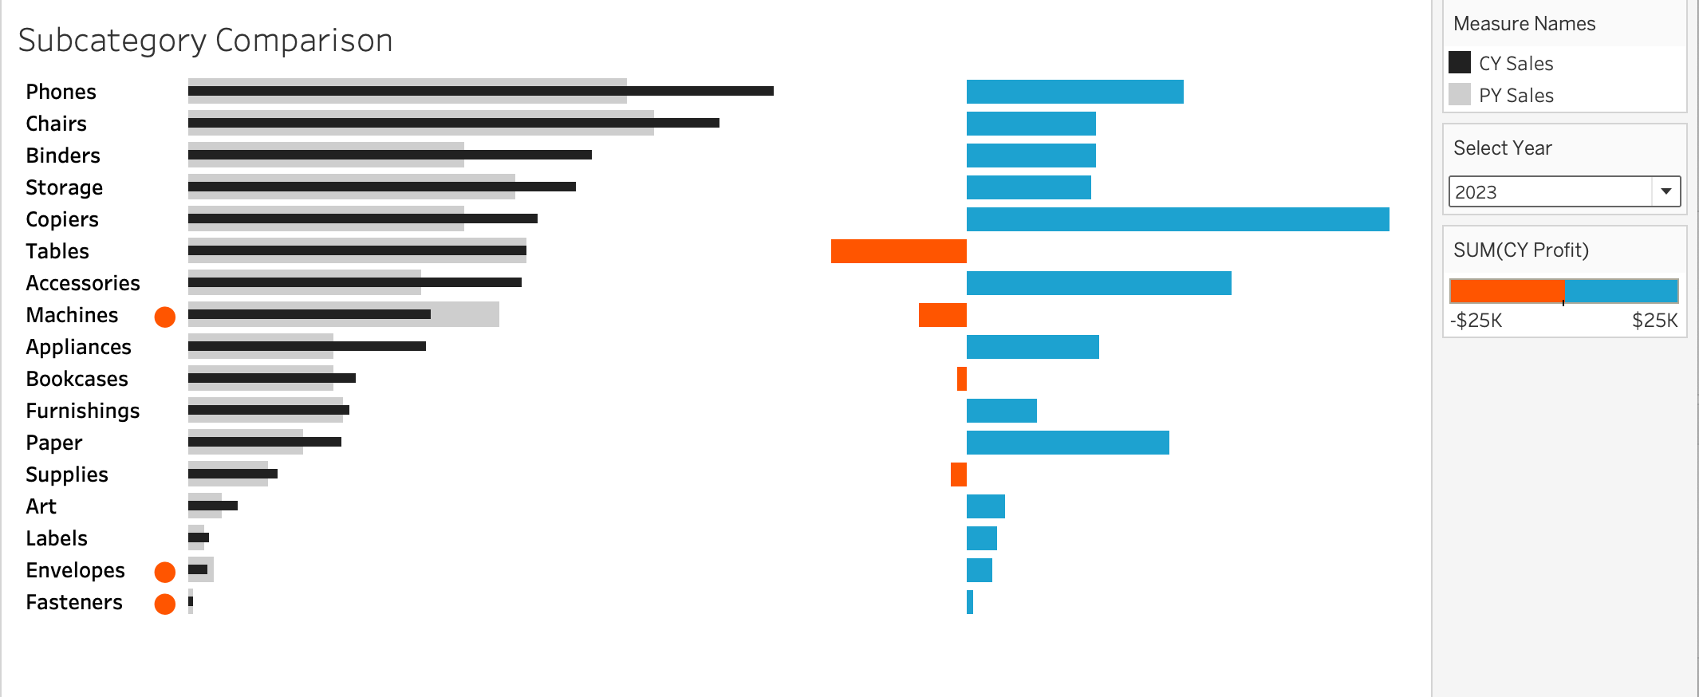
Sales Dashboard Product Comparision
Sales performance listed by various product subcategories for the current and previous years
Comparison of sales and profit margin, showing which product category performed poorly
School of Business, Economics, and Technology
4

Slide 8
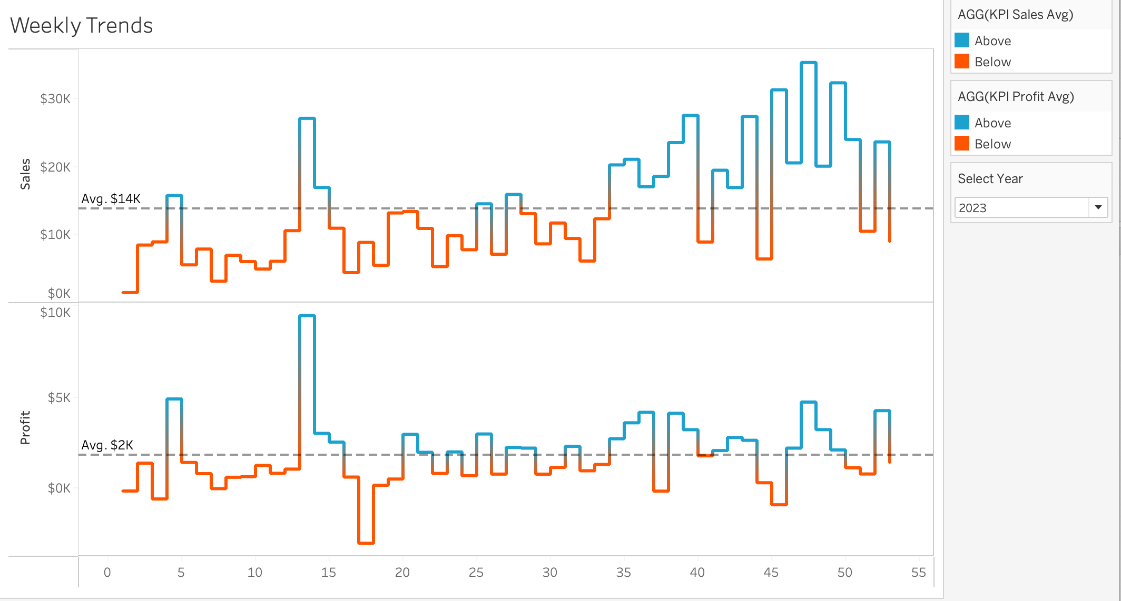
Sales Dashboard Weekly Trends
Weekly sales and profit data for the
current year
Display of average weekly values
Highlight weeks that are above and
below the weekly average as an
indicator of sales & profit
performance
School of Business, Economics, and Technology
4

Slide 9
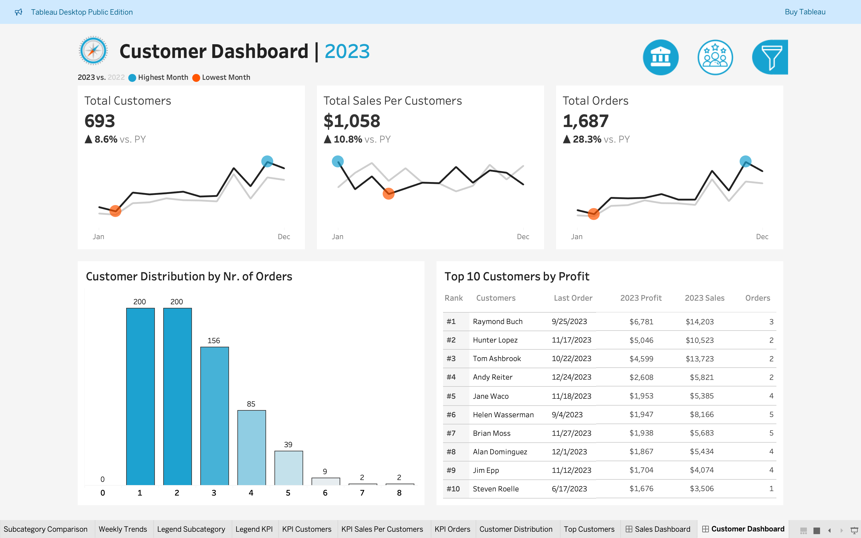
Customer Dashboard
Objective
Offer an overview of customer data and trends
Better identify client categories to boost customer management
(Singh et al., 2023)
School of Business, Economics, and Technology
4

Slide 10
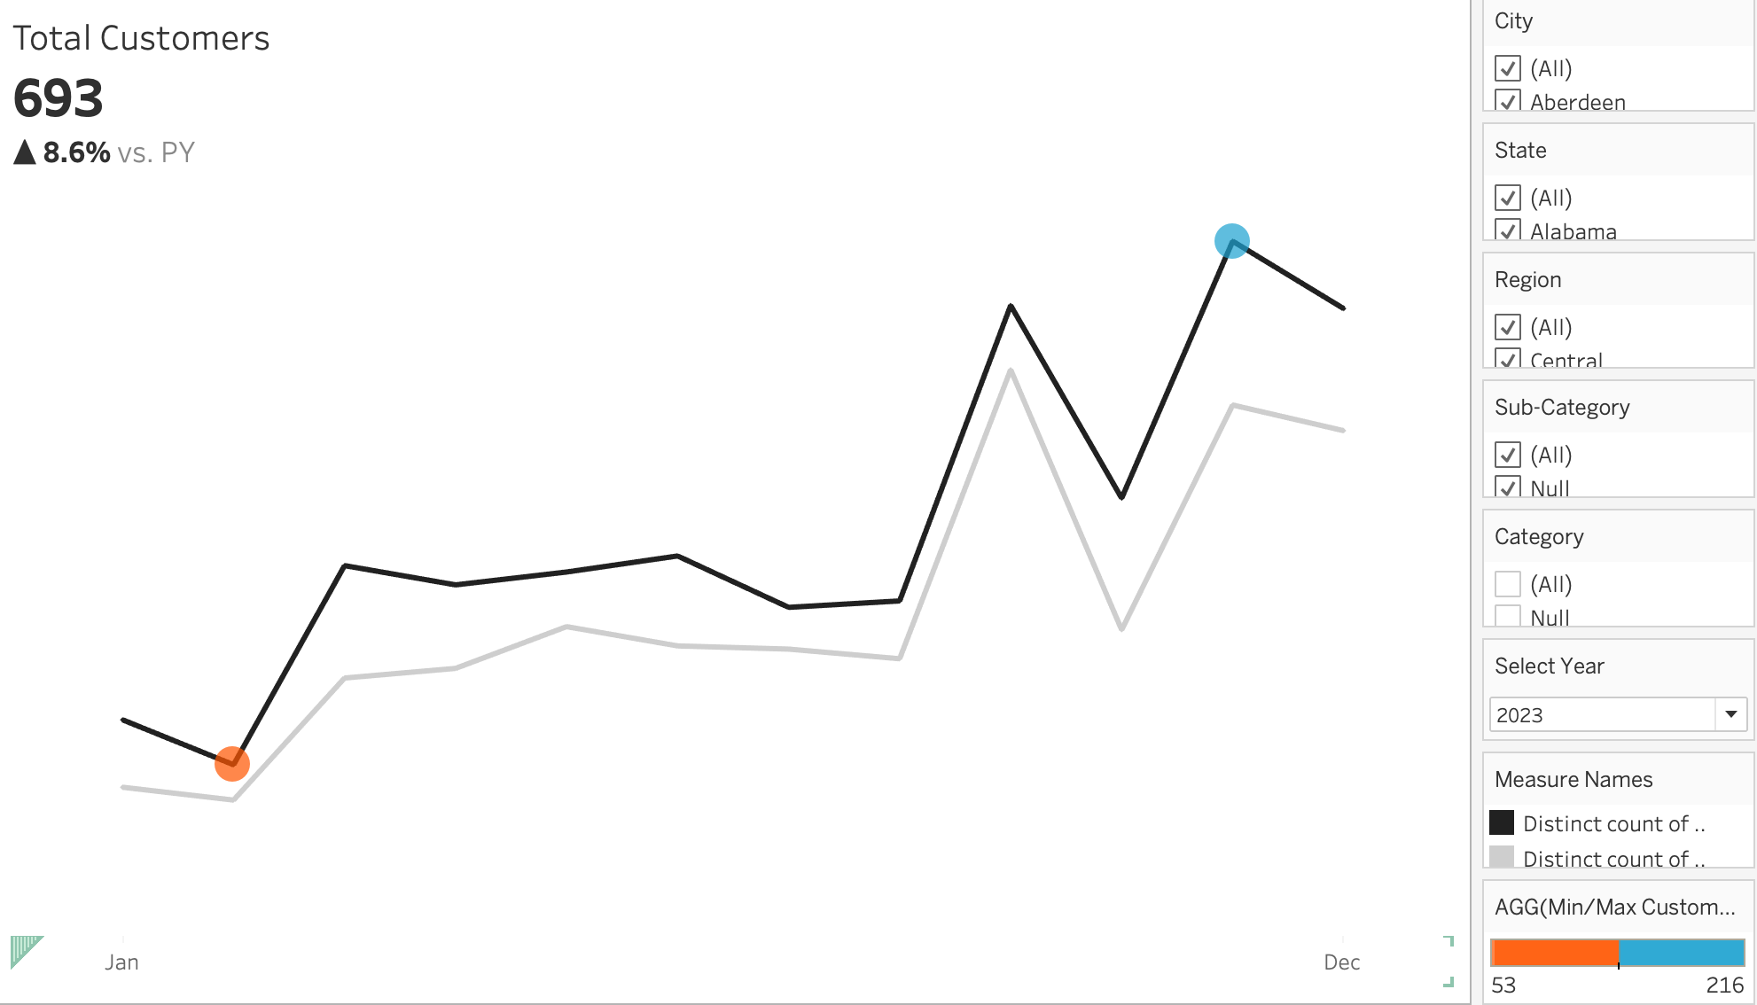
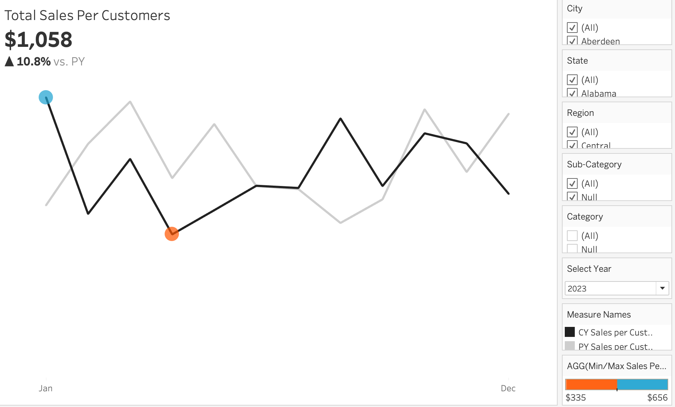
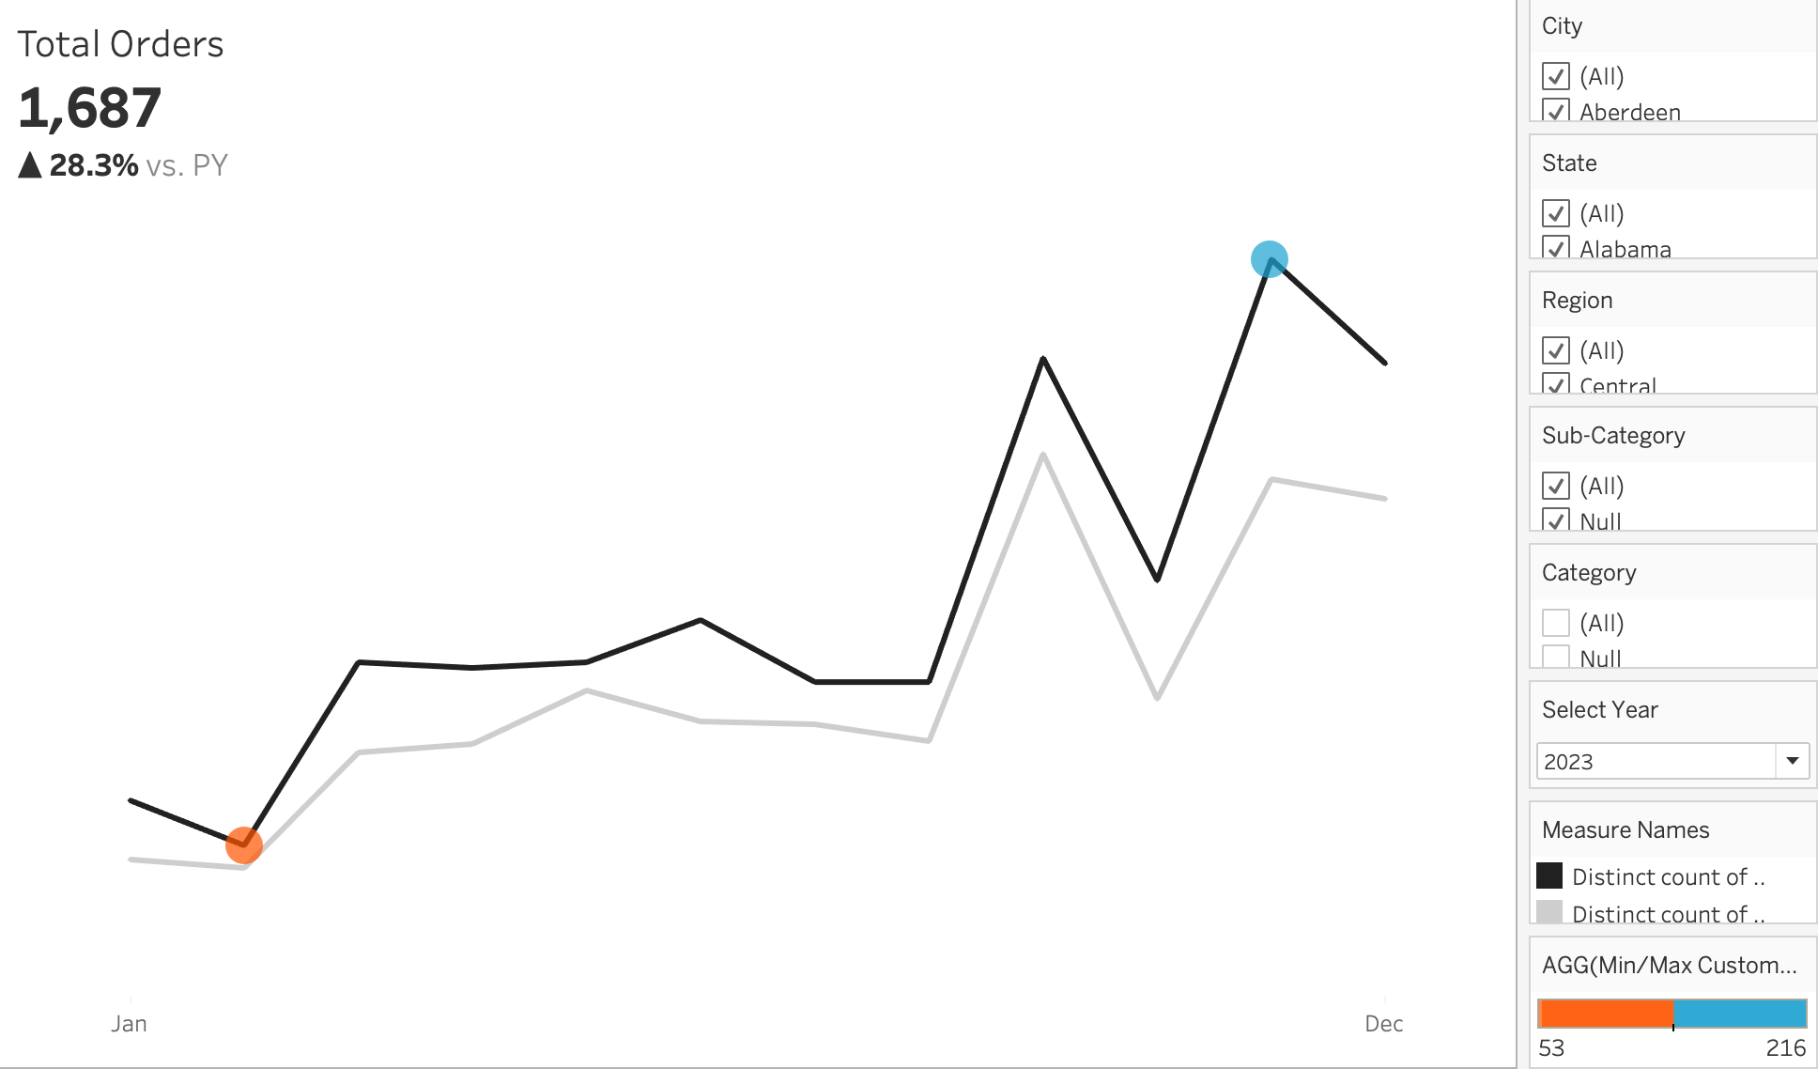
Customer Dashboard KPI Overview
Present the monthly data for each KPI listed below for both the current and previous years
Easily identify months with best and poor performing sales
KPI Customers
KPI Sales per Customer
KPI Orders
School of Business, Economics, and Technology
4

Slide 11
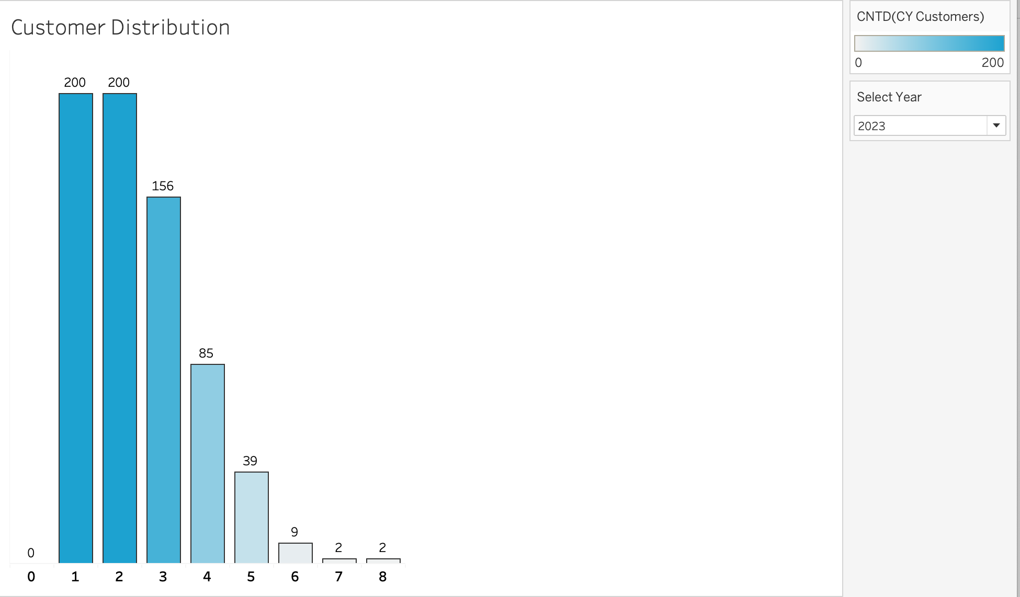
Customer Distribution
Represent the customer distribution based on placed orders
Provide insights into customer behavior and engagement
School of Business, Economics, and Technology
4

Slide 12
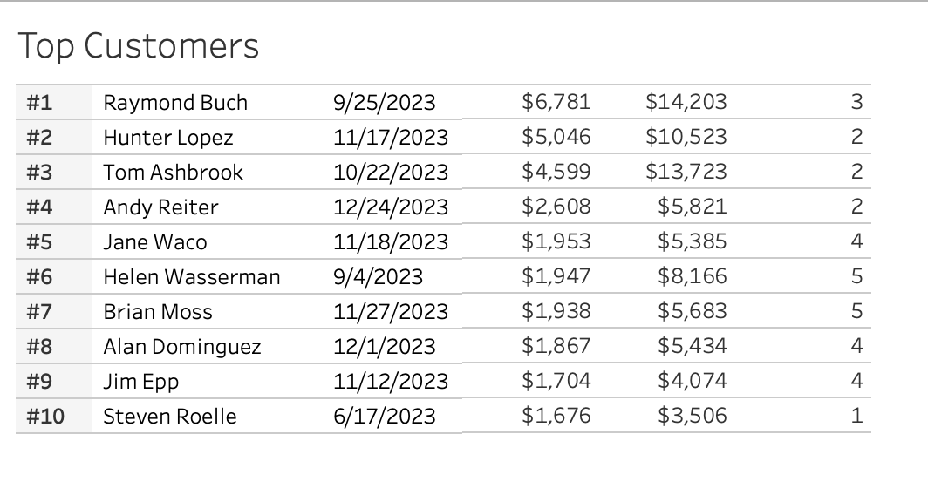
Customer Dashboard Distribution Contd.
Display top 10 high profit customers
Display information, such as current ranking, current sales, number of orders, current profits, and last date of order
School of Business, Economics, and Technology
4

Slide 13
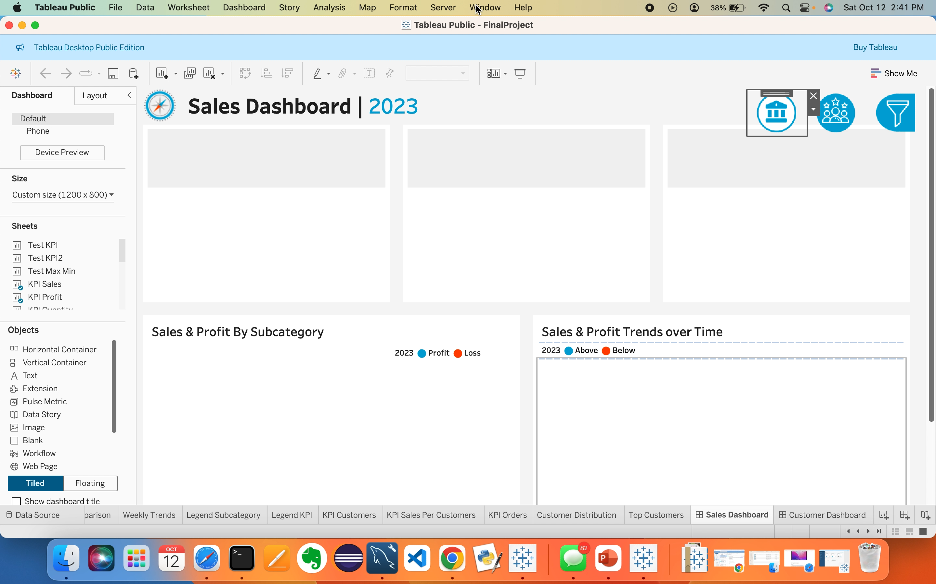
Interactive Dynamic Dashboard
Link to public dashboard -
https://public.tableau.com/app/profile/jamuna.mahalingam/viz/SalesCustomerDashboardsDynamic_17286981407710/CustomerDashboard?publish=yes
Video Demonstration of Dynamic Dashboard
School of Business, Economics, and Technology
4

Slide 14
Conclusion
A Tableau dashboard has been built to assist management in understanding their profit margin, sales performance and best performing products over the year range 2020-2023
Customer analysis has been done to show the best performing customers, and the most profitable product segments.
These data insights can help drive marketing campaigns for optimal company success.
School of Business, Economics, and Technology
4

Slide 15
Thank you!
School of Business, Economics, and Technology
12

Slide 16
REFERENCES
‌Kallel, M. B. E., Bouajaja, S., & Elloumi, A. (2024). Developing a Sales Dashboard with Power BI – A Case Study in a Pharmaceutical Company. Decision Making Advances, 2(1), 142–147. https://doi.org/10.31181/dma21202438
Parhusip, H. A., Trihandaru, S., Heriadi, A. H., Santosa, P. P., & Puspasari, M. D. (2022). Data Exploration Using Tableau and Principal Component Analysis. JOIV : International Journal on Informatics Visualization, 6(4), 911. https://doi.org/10.30630/joiv.6.4.952
Peesker, K. M., Kerr, P. D., Bolander, W., Ryals, L. J., Lister, J. A., & Dover, H. F. (2022). Hiring for sales success: The emerging importance of salesperson analytical skills. Journal of Business Research, 144, 17–30. https://www.sciencedirect.com/science/article/pii/S0148296322000820
Singh, C., Manoj Kumar Dash, Sahu, R., & Kumar, A. (2023). Artificial intelligence in customer retention: a bibliometric analysis and future research framework. Kybernetes. https://doi.org/10.1108/k-02-2023-0245
Sinlae, F., Yasir, M., & Muhajirin, A. (2024). APPLICATION OF BUSINESS INTELLIGENCE IN THE ANALYSIS AND VISUALIZATION OF XYZ UNIVERSITY ALUMNI DATA USING THE TABLEAU PLATFORM. JURTEKSI (Jurnal Teknologi Dan Sistem Informasi), 10(2), 209–216. https://doi.org/10.33330/jurteksi.v10i2.2612
‌
‌
‌
‌
‌
‌
‌
‌
School of Business, Economics, and Technology
13

